Slide 1
Effects, Data fetching & React Router

Slide 2
useEffect Hook
useEffect is a React Hook used to perform side effects in functional components.
Side effects are operations that happen outside the normal UI rendering.
It runs after the component renders.
Common Side Effects
API / data fetching
Updating document.title
Timers (setTimeout, setInterval)
Event listeners

Slide 3
Dependency Array
The dependency array controls when the effect executes.
1. No Dependency Array
useEffect(() => {
console.log("Effect");
});
Runs after every render

Slide 4
2. Empty Dependency Array
useEffect(() => {
console.log("Effect");
}, []);
Runs after the initial render

Slide 5
3. With Dependencies
useEffect(() => {
console.log("User changed");
}, [user]);
Runs when user changes.
Important Point :
Dependencies decide when the effect should re-run.

Slide 6
Data Fetching
Data fetching means retrieving data from an external source, usually a backend API.
Common Sources
REST APIs
backend
Databases through APIs
Third-party APIs
Firebase

Slide 7
Fetch API
What is Fetch?
fetch() is a built-in JavaScript API used to make HTTP requests.
Important
With Fetch, JSON needs to be converted manually:

Slide 8
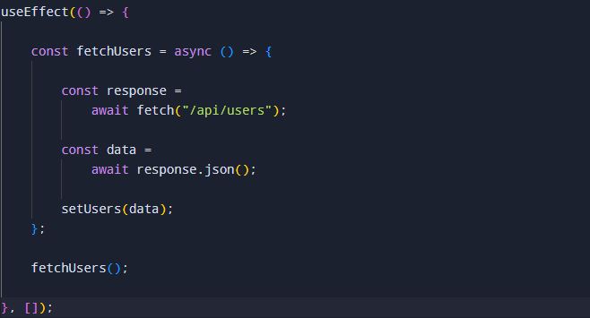
Fetch with useEffect

Slide 9
Axios
What is Axios?
Axios is a popular HTTP client library used for making API requests.
Installation : npm install axios
Axios handles the JSON response automatically

Slide 10
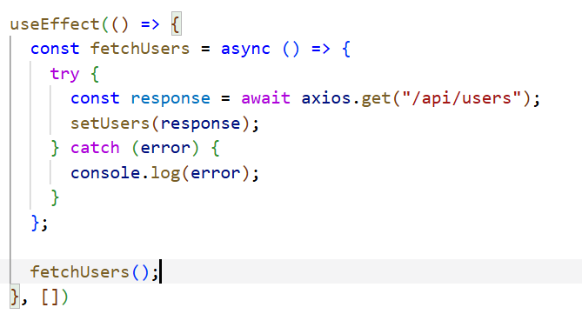
Axios with useEffect

Slide 11
React Router
React Router is a library used to implement routing and navigation in React applications.
It allows different URLs to display different components without completely reloading the page.
Installation : npm install react-router-dom
BrowserRouter, Routes, Route
Link
useNavigate, useParams, useLocation
Dynamic routes
404 / Not Found route

Slide 12
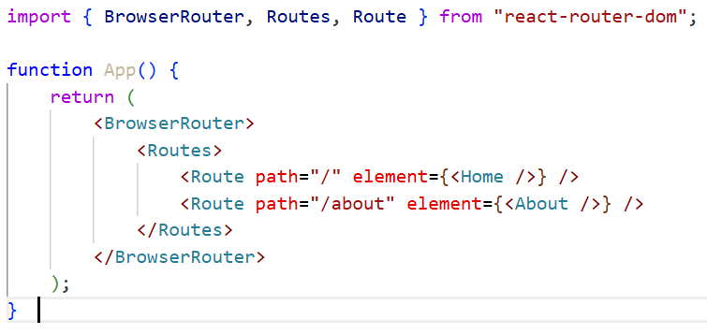
React Router Setup

